Slide 1
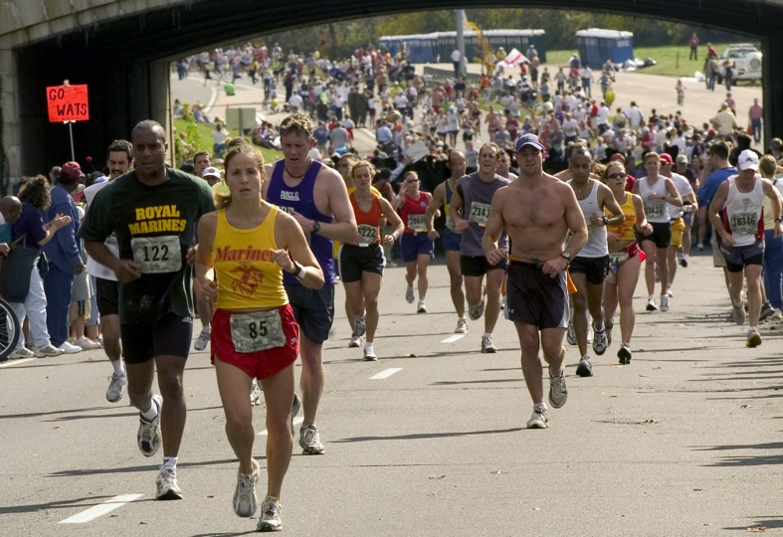

Slide 3
Great schools row as one; they are quite clearly in the same boat, pulling in the same direction in unison. The best schools we visited were tightly aligned communities marked by a palpable sense of “we.”
Lickona and Davidson,2005,
p.65

