Slide 1
Evokes Awareness
Eight Ideas To Evoke Awareness With Your Clients

Slide 2
Evokes Awareness
Facilitates client insight and learning by using tools and techniques such as powerful questioning, silence, metaphor, or analogy

Slide 3
Evokes Awareness
Asking them to "flip the script", reframing their current thinking ex. if they are looking at something from a negative point of view ( seeing themselves as a victim) , what would it look like to see it from a positive perspective? ( seeing themselves as a victor)
“Reflect on the past" - when they are struggling with moving forward. Ask them to think of a time in their past when they successfully moved forward in a complex (or similar) situation. What did it take to do this? How were they able to accomplish it? How did they feel once they were successful? What could they use from that experience that might help them in their current situation? These are some of the probing questions I might ask with this activity.

Slide 4
Evokes Awareness
The impact of assumptions.
“OK – so I heard you say your direct reports are incompetent. How does that belief impact you?”
Observe how the client’s statement impacts you.
” Wow! When you said that you felt freedom, my whole body felt lighter. How did that feel for you?”

Slide 5
Walking The Ladder
As coaches, our goal is to challenge and refine the beliefs and assumptions that influence our clients’ perspectives.
The ladder of inference particularly helps coaches help their clients examine sensitive triggers for specific behaviors and understand why they feel and act in certain ways.
This tool helps clients revisit the situation and relook at all the facts again to see if other conclusions can be drawn from it.

Slide 6
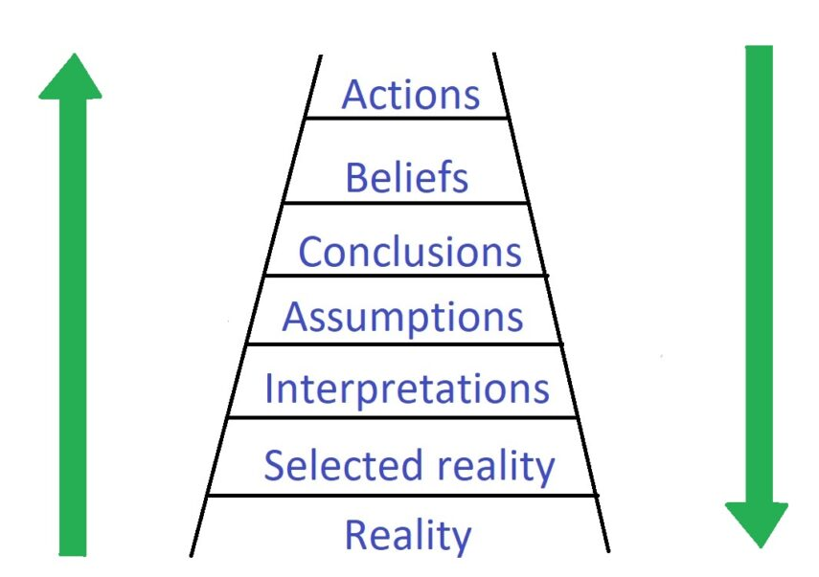
Walking The Ladder

Slide 7
Time Machine
“Future Pacing” helps a client with a goal that is future tense and intrinsically motivating.
Ask a client to imagine they are getting a a time machine and it will take them 12 months into the future.
Then ask the client questions that bring this new time into perspective. Then ask the client to de engineering how they got to that spot and what goals they need to focus on.

Slide 8
Evokes Awareness
Clean Language
Stretch your client's awareness by providing the space for them to go deeper into their thoughts.
Drawing
Ask your client to draw how they feel. Towards the end of the session, ask them to draw a current state OR ask them what changes in the picture.

Slide 9
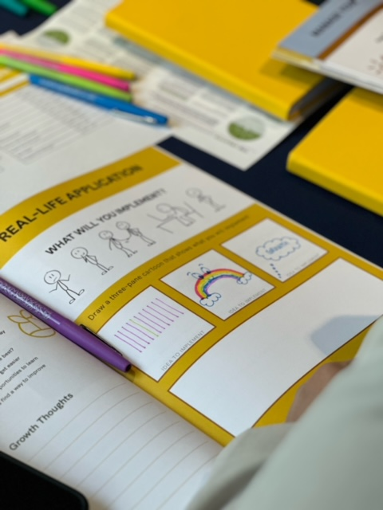
Creative Learning
Ask your client to draw how they feel. Towards the end of the session, ask them to draw a current state OR ask them what changes in the picture.

